Slide 1
Lecture 3: Divide and Conquer Algorithms (II)
Dr. Tsung-Wei Huang
Department of Electrical and Computer Engineering
University of Utah, Salt Lake City, UT
Notes:
Alright, good afternoon everybody. Today we are going to continue our journey on divide and conquer algorithms and this will be the last series about this recursive very powerful appraoch that is widely used in many practical applications.

Slide 2
Divide and Conquer Recap
Divide and Conquer is a recursive algorithm
Three essential steps:
Divide: If the input size is too large to handle efficiently, divide the data into two or more disjoint subsets
Recurse: Keeps partitioning the data until a small size reasonable to solve
Conquer: Take the solutions from the subproblems and “merge” them to a solution from the division point
Notes:
Let’s review again the divide and conquer approach. Divide and conquer is an algorithm template or framework that is used to handle large problem. A lot of time, when you have a very big problem, it is too difficult to solve the original problem in a flat space. Instead, we tend to break down the problem into small and manageable pieces, and solve each subproblem recursively. When you come back from the recursion, you need a way to merge the solution from each partition. Because the optimal solution per partition may be local optimal, it may not be a global optimal when you combine two partitions.
The standard paradigm for divide and conquer is outlined as follows: three essential steps: Divide, Recurse and conquer. (explain …)

Slide 3
Visualization of Divide and Conquer
Divide
If small
else
Solve Directly
Notes:
In terms of visualization, divide and conquer looks ike this.

Slide 4
Visualization of Divide and Conquer
Recursive

Slide 5
Visualization of Divide and Conquer
Solve and Conquer

Slide 6
Example: Find the 2D Maximal Points
Brute-force method
Write a two-level for-loop to compare all pair of points
Compare all pairs of points Time Complexity：O(n²)
Y
X
Notes:
Last time we ended up with this very famous example of finding the 2D maximal points in a plane. (explain brute-force)
But this brute force method has a problem. Its complexity is (explain …) using our empirical analysis, if you want to finish the problem within one second on a modern computer, the large size you can handle is probably just 2000. That is not very good.

Slide 7
Find 2D Maximal Points using Divide and Conquer
Input: A set S of n planar points (sorted along x).
Output: The maximal points of S.
Step 1: If S contains only one point, return it as the maxima. Otherwise, find a line L perpendicular to the X-axis which separates S into S_{L} and S_{R}, with equal sizes.
Step 2: Recursively find the maximal points of S_{L} and S_{R} .
Step 3: Find the largest y-value in S_{R}, denoted as y_{R}. Discard each of the maximal points in S_{L} if its y-value is less than y_{R}.
Notes:
So we talked about a better approach using divide and conquer. That essentially gives us a faster runtime and reduces the complexity from ON2 to ONlogN. That is a very huge saving. Keep in mind, if you are able to reduce the time complexity by an logarithmic order of magnitude, that is a huge gain. It’s a game changer.
The divide and conquer algorithm for 2D maximal points finding is as follows:

Slide 8
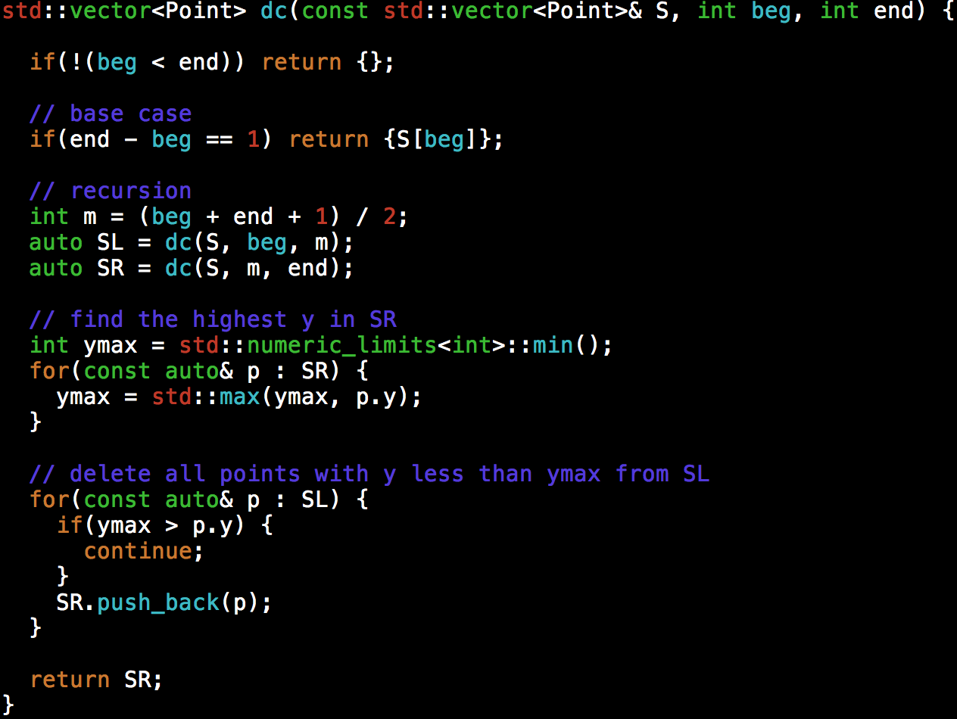
Notes:
This slide gives you the solution to this divide and conquer approach. (explain)

Slide 9
The 2D Closest Pair of Points Problem
Given a point set at a 2D plane, find a pair of points with the minimum distance
1-D version:
2-D version:
Y
X
Sort and scan
X
Notes:
Now let’s talk about another problem, the 2D closest pair of points problem. We are given an array of n points in the plane, and the problem is to find out the closest pair of points in the plane or in an array storage. This problem arises in a number of applications. For example, in air-traffic control, you may want to monitor planes that come too close together, since this may indicate a possible collision. Or in a large circuit design, you may want to find out the cloest pair of connected components to avoid some electrical problems.
For example, the cloesest pair of points is these two points.
The Brute force solution is O(n^2), compute the distance between each pair and return the smallest.

Slide 10
Divide and Conquer Algorithm
Input: A set S of n planar points.
Output: The distance between two closest points.
Step 1: Sort S in increasing order of x values
Step 2: If S contains only one point, return infinity as its distance.
Step 3: Find a median line L perpendicular to the x-axis and divide S into S_{L} and S_{R} with equal sizes.
Step 4: Recursively apply Steps 2 and 3 to solve the closest pair problems of S_{L} and S_{R}. Let d_{L}(d_{R}) denote the distance between the closest pair in S_{L} (S_{R}). Let d = min(d_{L}, d_{R}); Find a stripe of +d/-d from the mid point and search the minimum distance within the stripe; return the minimum

Slide 11
Illustration
Step 1: sort points by increasing order of x values
Step 2
Step 3
If only one point
Divide by the mid-x point
Y
Y
L
S_{L}
S_{R}
d = ∞
X
X

Slide 12
Illustration
Step 4
Y
L
L
S_{L}
S_{R}
X

Slide 13
Illustration
Step 5
Y
L
S_{L}
S_{R}
d_{L}
d_{R}
X
L-d
L+d
d=min(d_{L},d_{R})
Notes:
Now, the interesting part is the merge step, the conquer step. When you come back from the previous recursion, we have found the minimum distance in each partition SL and SR, right. But the individual minimum distance is not necessary the minimum distance of the entire partition SL + SR because you may have the minimum cross the middle. We need to find a way to efficiently dig out the minimum distance across the middle. How can we do that (click and explain)
I only need to check those points in the strip line at most "d" distance away from the middle line that divides SL and SR. Any other points outside the strip are not in my interest because their distance is definitely larger than the minimum value d I already have.
The great thing about this property is, we can sort these points in an increasing order of their y values, and compare the distance of every pair of points from the lowest y to the highest y. Whenever we find a pair with y-distance larger than d, we can prune at there.

Slide 14
Illustration
You will not search too many points in the strip
Y
P
2d
d
X

Slide 15
Maximum Subarray Sum Problem
Given a sequence of integer number, find the largest sum of contiguous array numbers
Notes:
The next example I am going to talk about is the maximum subarray sum problem. This is also another famous example of divide and conquer. Given a ...
That is, you are given a one dimensional array that may contain both positive and negative integers, find the sum of contiguous subarray of numbers which has the large sum. For example, if the array is -2, -3, ... etc, then the maximum subarray sum is 7.
Why is this problem important?

Slide 16
Practical Application I
A basic routine of financial computing
Maximum subarray sum to find the optimal long-term investment
Notes:
Well, this is in fact a question I was asked by a financial company when I took an interview. If you look at stock market, the price over time changes a lot, right. It can go very low today, and become very high tomororw or next week, or even wihin the next couple hours.
If you look at a short-term investment, you always want to find a contiguous range that produces the maximum sum within a time period (of course, it has to be contigious because you buy the stock and then sell it, there is no other options)
So the problem is alwasy modelled as a sequence of numbers, positive and negative, potentially very large, and you want to quickly compute the largest subarray sum. And that gives you the best profit you may get in that certain period.

Slide 17
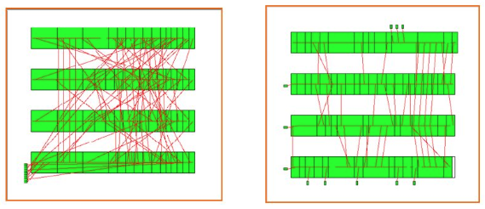
Practical Application II
Row-based VLSI detailed placement
Maximum/minimum subarray sum to find per-row wirelength
Notes:
Another application is the row-based VLSI detailed placement.

Slide 18
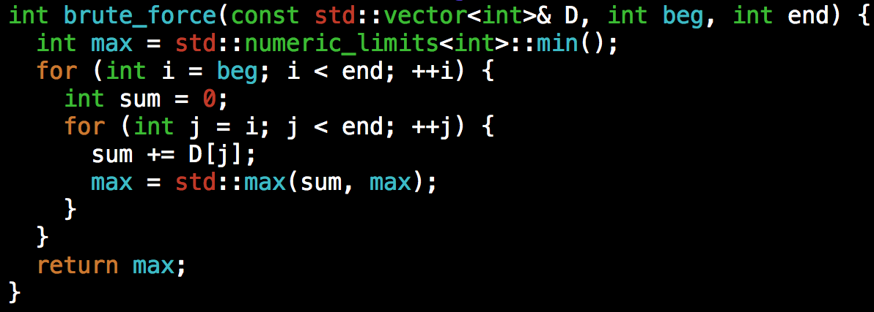
Brute Force?
Run two loops
Notes:
Now, let's go back to the problem itself.
Again, we always start with the simple approach, even though it is slow. At least you need to be able to find the solution first before you can improve it.
Any idea?
(click) The naive method is to run two loops. The outer loop picks the beginning element, the inner loop finds the maximum possible sum with first element picked by outer loop and compares this maximum with the overall maximum. Finally return the overall maximum. The time complexity of the Naive method is O(n^2).

Slide 19
Divide and Conquer
Step 1: If the array has fewer than 3 elements, go brute force
Step 2: Partition the array into two halves of equal size. Recursively find the maximum subarray sum of S_{L} and S_{R} .
Step 3: Merge two sums from S_{L} and S_{R}. Find the maximum subarray sum across the mid point. Return the overall minimum

Slide 20
Sorting
The most fundamental algorithm in all subjects …
Goal: puts elements in a certain order
Increasing order: 1, 2, 5, 6, 8, 90, 123
Decreasing order: 123, 90, 8, 6, 5, 2, 1
Many algorithm paradigms
Bubble sort
Selection sort
Merge sort
Qsort
…
Today, new sorting algorithms are being invented
Notes:
Then next topic we are going to talk about is sorting. As you can imagine, sorting is the most fundamental algorithm in all computer science and computer engineering subjects. The goal is to put elements in a certain order, often increasing order or decreasing order.
(explain)

Slide 21
Selection Sort
Two loops
Outer loop to repeat n-1 times
Inner loop to find the minimum element
Notes:
Selection sort is one of the simplest methods in the sorting area. The idea is to iteratively scan the sequence of numbers and pick up the number with the minimum or maximum value. That means you will have two loops. The outer loop repeat n-1 times and the inner loop is to find the minimum element.
Intuition is, you need n steps to find the minimum over a sequence of n numbers, right? And how many times do you need in order to make everything sorted.
Explain.

Slide 22
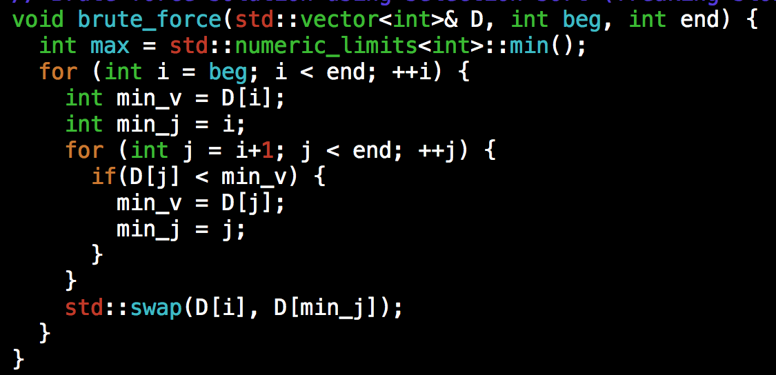
Selection Sort Implementation
Time complexity O(N²)

Slide 23
Using Divide and Conquer: Merge Sort
Divide: If S has at two or more elements (nothing needs to be done if S has zero or one elements), remove all the elements from S and put them into two sequences, S_{L} and S_{R}, each containing about half of the elements of S. (i.e. S_{L} contains the first ⎡n/2⎤ elements and S_{R} contains the remaining ⎣n/2⎦ elements.
Recurse: Recursively sort sequences S_{L} and S_{R}.
Conquer: Put back the elements into S by merging the two sorted sequences S_{L} and S_{R} into a sorted sequence.

Slide 24
Illustration
0
1
2
3
4
5
6
start
20
90
40
30
80
70
50
n = 7
mergesort(a, 0, 6)
1
11
mergesort(a, 0, 3)
mergesort(a, 4, 6)
0
1
2
3
4
5
6
20
90
40
30
80
70
50

Slide 25
Illustration
0
1
2
3
4
5
6
20
90
40
30
80
70
50
2
6
12
16
msort(a, 0, 1)
msort(a, 2, 3)
msort(a, 4, 5)
msort(a, 6, 6)
0
1
2
3
4
5
6
20
90
40
30
80
70
50
3
4
7
8
13
14
0
1
2
3
4
5
20
90
40
30
80
70

Slide 26
Illustration
0
1
2
3
4
5
6
20
90
40
30
80
70
50
5
9
15
0
1
2
3
4
5
20
90
30
40
70
80
10
17
0
1
2
3
4
5
6
20
30
40
90
50
70
80
18
0
1
2
3
4
5
6
20
30
40
50
70
80
90

Slide 27
Merge Sort Complexity
Run Time Analysis
At each level in the binary tree created for Merge Sort, there are n elements, with O(1) time spent at each element
O(n) running time for processing one level
The height of the tree is O(log n)
Therefore, the time complexity is O(nlog n)

Slide 28
Summary
2D closest pair of points finding
Commonly used in computational geometry
Maximum subarray sum
Commonly used in financial computing and VLSI designs
Sorting
Selection sort (kinda brute force: O(N²))
Merge sort (divide and conquer: O(nlogn))

Slide 29
Note
To compile a “test.cpp” program to a binary “test”
g++ test.cpp -O2 -o test
To feed a program with a test file from the standard output:
./simple < test.txt
To measure the runtime of the above program:
time –p ./simple < test.txt

